Slide 1
Meeting the Needs of All Students: Co-Teaching
October 17, 2022
Englewood on the Palisades Charter School
Office of Principal
Office of Specialized Instructional Services
Office of Teaching & Learning
Notes:
1. Welcome participants and complete introductions of facilitators; review purpose and goals for Co-Teaching PD. (One Message, One Voice)
2. Explain to faculty that this year not only will K-2 have Assistant Teachers (all with substitute certifications) but there will also be push-in support from Special Education Teachers, eLL Teachers and Interventionists.
3. In order to propel student learning outcomes we must maximize the impact of every educator in the classroom. Effectively implementing the co-teaching model will empower us to increase the efficacy of all educators which will result in increased learning outcomes for all of EPCS’s students.
‹#›

Slide 2
Goals
Essential Question: How can all stakeholders benefit from various models of co-teaching in order to foster academic achievement and effectively promote success for all learners?
Desired Outcomes:
Identify the benefits and challenges of Co-Teaching
Explore the six models of Co-Teaching
‹#›
Notes:
Facilitator will review essential question and desired outcomes with participants.
Throughout the district we have seen various forms of co-teaching models. As a district we want to make certain that we send one message and that you receive the proper professional development to support this practice.
Today you will have the opportunity to see 6 various models of co-teaching.
‹#›

Slide 3
Why Co-Teach?
Increase Instructional Intensity
Increase active student engagement
Frequent checks for understanding
Students provided more opportunities to demonstrate skill acquisition
‹#›
Notes:
Increasing instructional intensity means to:
Ensure that students are actively engaged. This means that students are motivated to participate in the learning process; they are interacting with other students (i.e. structured interaction); and they are responding to instruction in a variety of ways (e.g. generating clarifying questions, generating and testing hypothesis, writing in response to reading, structured paired or group discussions, note-taking, mapping understanding…etc…)
Ensure that there is planned and structured checks for understanding by eliciting responses from students in a variety of ways (e.g. guided practice, think-pair share, small group response to project based opportunities…etc…).
Ensure that students have ample opportunities to demonstrate the skills they have mastered. Give plenty of forethought to the types of activities (i.e. student work product) available to students to demonstrate their mastery of the skills covered in a lesson/lesson unit.
‹#›

Slide 4
Alternative to Our Current Practice…WHY?
Access, Participation, and Progress
To the general education curriculum
To the general education teacher
To preparation for statewide assessments
To peers
‹#›
Notes:
‹#›
1. Facilitators will stress the importance of not just talking about access…Emphasize PARTICIPATION and PROGRESS in the general curriculum as well as access.
Expected benefit to all students
Increased cognitive strategies and study skills
Increased social skills
More engaged time
More time with and attention from teachers
Improved classroom communities
Reduce isolation of pull-out programs

Slide 5
Assess, Plan, Differentiate and Evaluate
General Education Teacher
Learning Support / ESOL Teacher
Teach
Teach
ALL Students
‹#›
Notes:
‹#›
Goal: To provide support for ALL students (advanced, on-target, struggling learners)
A service delivery system in which teachers have a contract to share instructional responsibility. The shared responsibility is:
•For a single group of students
•Primarily in a single classroom
•For specific content (objectives)
•With mutual ownership, pooled resources, and joint accountability
•Although each individual’s level of participation may vary.
2. Facilitators will emphasize that in the co-teaching model there are two or more educators.
3. Para-educators and /or parent volunteers are support personnel, not considered certified staff. These individuals are provided direction by the teaching staff as to their responsibilities within the classroom.

Slide 6
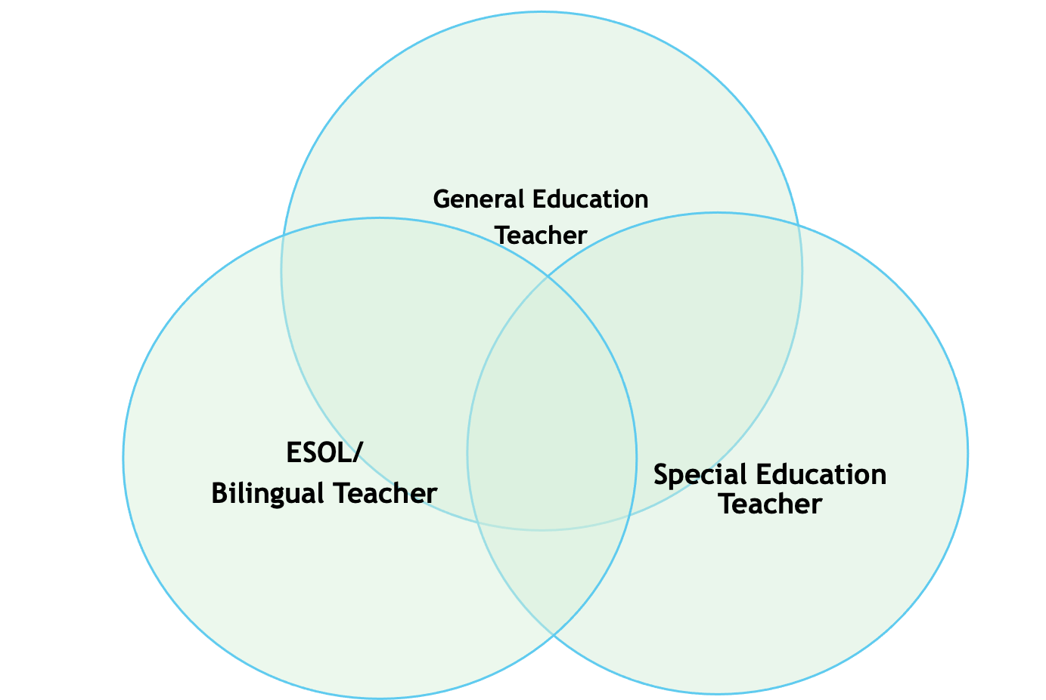
Whose Expertise is Needed?
Objective view of academic and social development
Pacing of Curriculum
Scope and sequence of curriculum
Management strategies for large groups
Content Knowledge
Identifying instructional needs for ELLs
Identifying instructional needs for special education
Second Language Theory
Learning Strategies
Special education law
Oral language development
Quality Teaching Rigor, Relevance & Relationships
Diagnostic/prescriptive teaching
Maintain high expectations
Deeper knowledge of grammar
Culturally Relevant Instructional Practices
Behavior modification techniques
Knowledge of Individual Education Plan (IEP)
Language Objectives
Pacing
Educational accommodations/ modifications
ELL Strategies
‹#›
Notes:
‹#›

Slide 7
Co-Teaching Models
One Teach, One Observe
Station Teaching
Parallel Teaching
Alternative Teaching
Teaming
One Teach, One Assist
‹#›
Notes:
Facilitators will instruct participants to take out handout which highlights six co-teaching models.
These are the six co-teaching models that we will learn about today. You will view a brief demonstration of each approach.
‹#›

Slide 8
The Power of 2: Co-Teaching Models
‹#›
Notes:
‹#›
Six Co-Teaching Strategies School of Education CSU, Chico: https://www.youtube.com/watch?v=RWB8cg0K3DE&list=PLCDsTyftAA2D_buI_Rti5phLZ1DdFsAMc
1. Participants are directed to watch the video of Class Practices with Co-Teaching
2. Participants are asked to fill out the handout “Co-Teaching” models as they watch the video clips.
3. After each co-teaching model segment, stop video, have participants discuss at their table groups what they saw and heard. After group discussions, share out as a whole group findings from one or two groups. Then, show related slide for each model.
4. Now show “One Teach, One Observe”
Disk 1, 27:30 part…Classroom Practice.

Slide 9
One Teach, One Observe
One teacher is primarily responsible for the design and delivery of lesson
Co-teacher observes, listens and takes anecdotal notes
‹#›
Notes:
‹#›
1. Refer to Handout: Co-Teaching Models
2. A model that is only to be used occasionally, especially at the beginning of the co-teaching process
3. Participants are asked to fill out the handout “Co-Teaching” models as they watch the video clips.
4. After each co-teaching model segment, stop video, have participants discuss at their table groups what they saw and heard. After group discussions, share out findings from one or two groups. Then, show related slide for each approach.
https://www.youtube.com/watch?v=S3AK33YOZfE
Guided Question - What type of data collection would be beneficial in for your class?

Slide 10
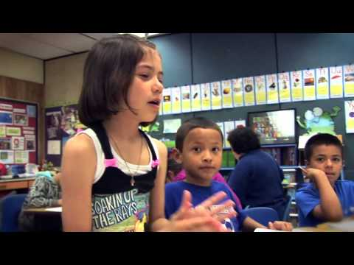
Station Teaching
Co-teachers divide content and students
Students rotate from one teacher to another
A third group works independently
‹#›
Notes:
‹#›
1. One teacher teaches half the content to half the students while the other teaches the other part to the rest.
2. Participants are asked to fill out the handout “Co-Teaching” models as they watch the video clips.
3. After each co-teaching model segment, stop video, have participants discuss at their table groups what they saw and heard. After group discussions, share
out findings from one or two groups. Then, show related slide for each approach
.
https://www.youtube.com/watch?v=1UyiaLS8UGQ
https://www.youtube.com/watch?v=hrprg1r7kSs
https://www.youtube.com/watch?v=hrprg1r7kSs&t=67s
Guided Question - What are three stations that could be created for a specific lesson?

Slide 11
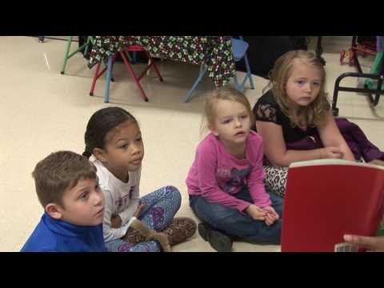
Parallel Teaching
Co-teachers teach the same content to different groups of students at the same time
Groups are heterogeneous
‹#›
Notes:
‹#›
1. This model takes place in the classroom. Groups are not separated into a different room.
2. Differentiated Instruction supports scaffolding instruction to the varying levels of learners in the heterogeneous groupings.
It is important to be aware of the noise level in the room.
4. Time is also a key component of this model. Groups have to finish at the same time.
5. Participants are asked to fill out the handout “Co-Teaching” models as they watch the video clips.
6. After each co-teaching model segment, stop video, have participants discuss at their table groups what they saw and heard. After group discussions, share
out findings from one or two groups. Then, show related slide for each approach.
https://www.youtube.com/watch?v=UmZeTuVTQrE
Guided question - Discuss a lesson that you would utilize Parallel Teaching

Slide 12
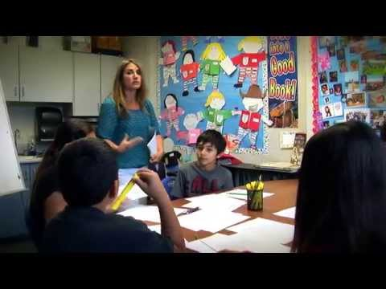
Alternative Teaching
One teacher is teaching a lesson to the whole group
Co-teacher is teaching the same information to a small group through a different approach
‹#›
Notes:
‹#›
https://www.youtube.com/watch?v=fr-S5CGDXBQ
1. Facilitator will review notations: Sometimes referred to as “Complementary Teaching.”
2. The learning outcome is the same. Co-teacher is teaching the smaller group using a more strategic approach to learning.
3. Grouping should not be static. They should be flexible, with ELL and SPED students in mixed grouping based on instructional needs.
4. Timing of the small group instruction:
Whole class period, few minutes, end of lesson, beginning of lesson
Purpose of Instruction:
Learning Strategies
Paraphrase
Pre-teach
Monitoring learning
Enrichment
Remediation
Supplemental skill instruction

Slide 13
Team Teaching
Co-teachers plan, design and deliver instruction
Co-teachers assume responsibility for all students
‹#›
Notes:
‹#›
Teachers equally share in the delivery of various components of the lesson. Everyone’s expertise is utilized.
Disadvantage – groups are larger which can lead to low instructional intensity
https://www.youtube.com/watch?v=MVeFjRdSH3c

Slide 14
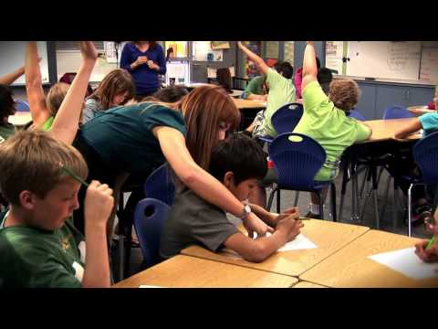
One Teach, One Assist
One teacher is primarily responsible for teaching the lesson
Co-teacher provides quiet assistance to students as needed
‹#›
Notes:
‹#›
1. Facilitators will stress: Sometimes referred to as One Teach, One Assist or Lead and Support; this model is an extension of One Teach, One Observe.
2. Should not be a Teacher and Teacher-Assistant Syndrome – this is where the co-teacher acts only as an assistant.
3. Although this model has some merit, it is often overused because it makes few demands for change.
4.Often this is the model that is used in the beginning of the co-teaching relationship because of the few demands it places on the co-teaching team members.
However, members begin to feel unsatisfied in this relationship.
5. To be used occasionally

Slide 15
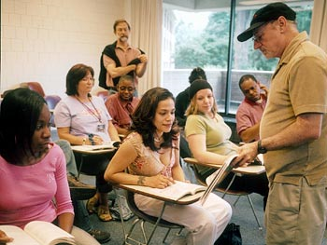
Classroom Environment
‹#›
Notes:
1. Ask participants to which co-teaching model is represented by the diagram.
‹#›

Slide 16
Classroom Environment
‹#›

Slide 17
Classroom Environment
‹#›

Slide 18
Classroom Environment
‹#›

Slide 19
Classroom Environment
‹#›

Slide 20
Classroom Environment
‹#›

Slide 21
A Thought…
If we are to create schools in which students
feel welcomed and part of a community, then we
must begin by creating schools that welcome the
diversity of all children.
-Norman Kunc
‹#›
Notes:
‹#›

Slide 22
Thank You!
‹#›
Notes:
1. Address questions and concerns and thank participants.
‹#›

